Slide 1
16th Deep Learning Meetup in Vienna
Vienna, February 2018
Demystifying Neural Word Embedding
Applications in Financial Sentiment Analysis, and
Gender Bias Detection
Navid Rekabsaz
TU Wien (current)
Idiap Research Institute – EPFL (next)
@navidrekabsaz
rekabsaz@ifs.tuwien.ac.at

Slide 2
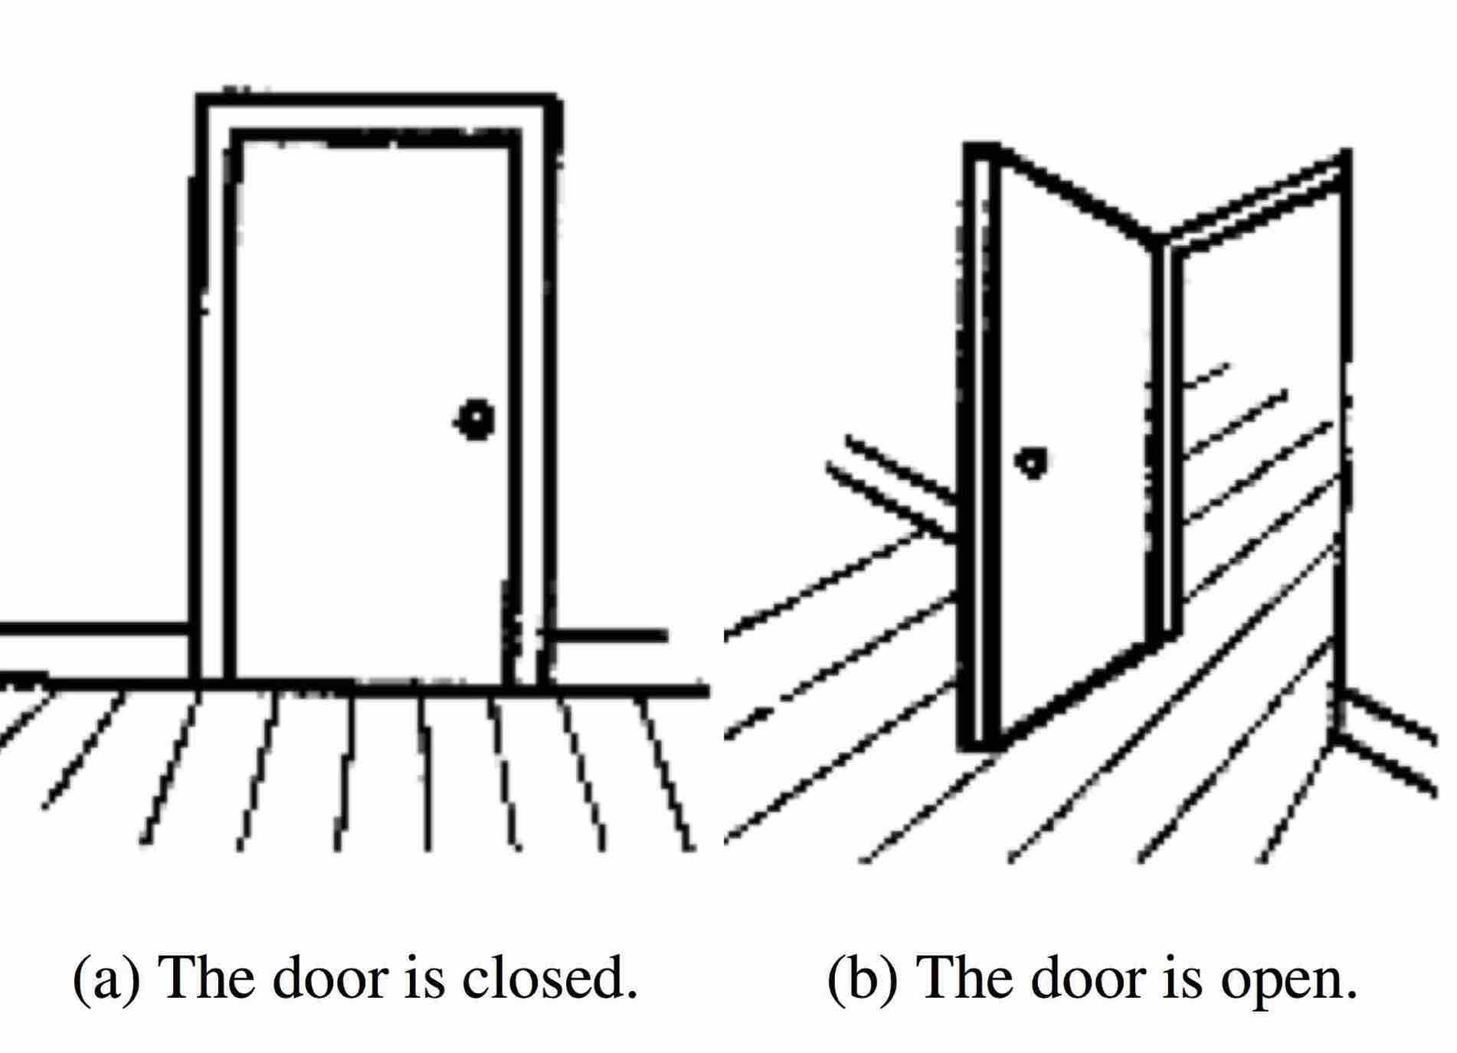
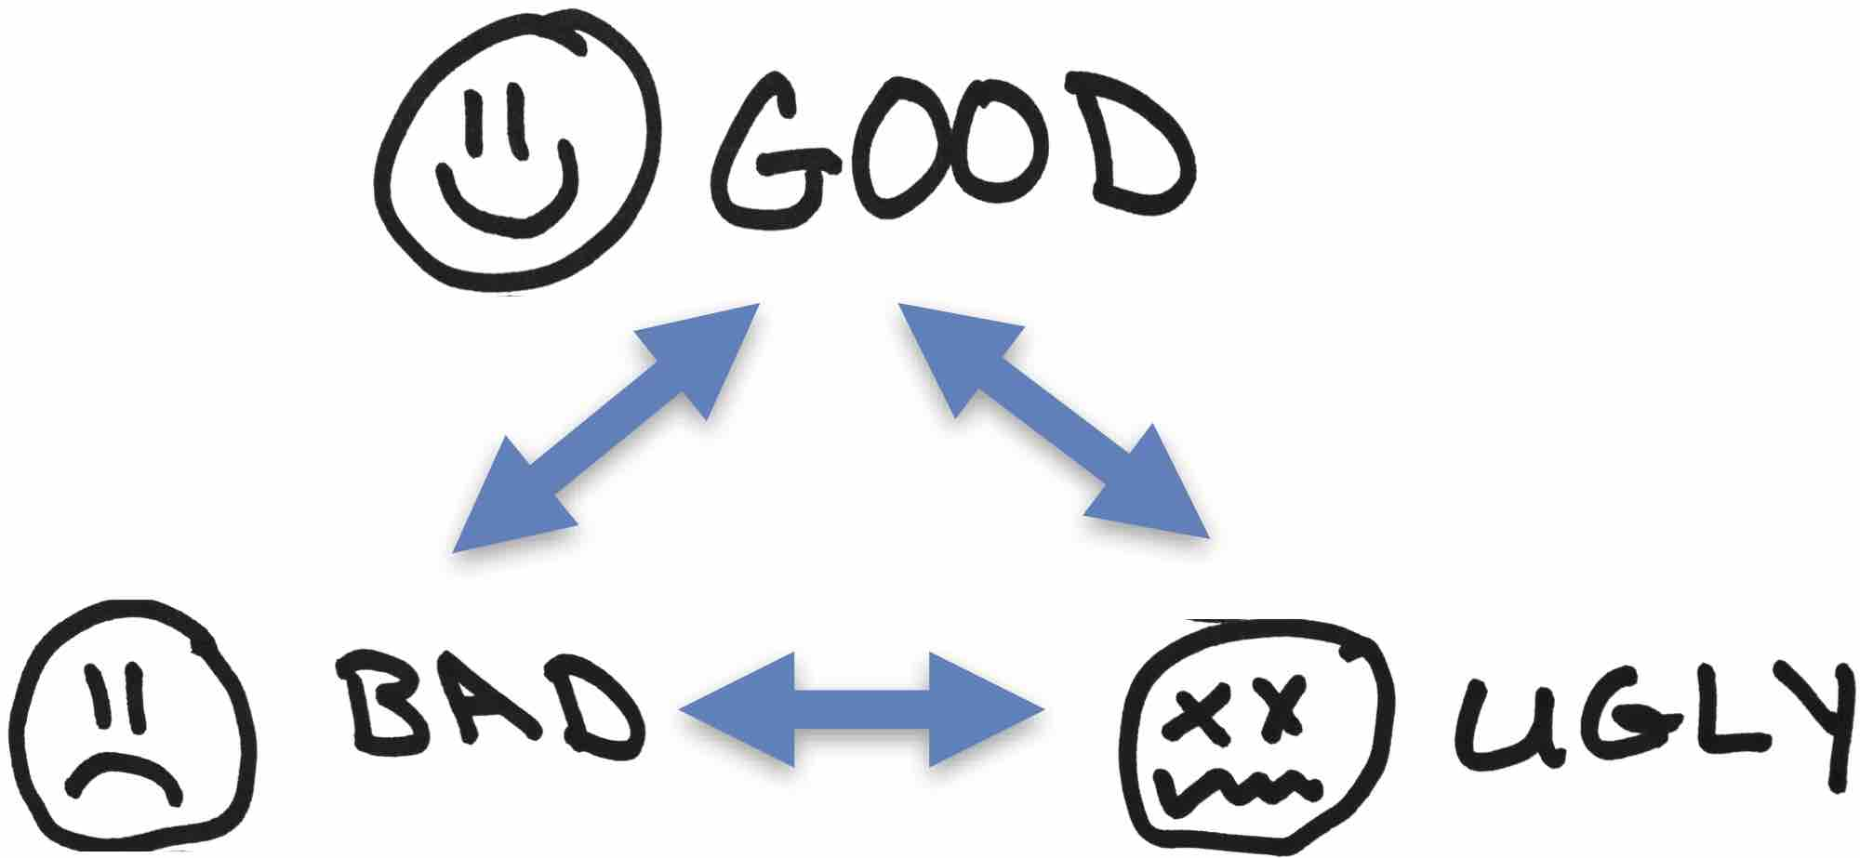
Semantics

Slide 3

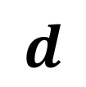
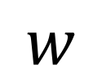
Semantic Vectors
A vector with d dimensions represents each word
Also called Word Embedding
Dimensions reflect the concepts in language
$$d$$
$$w$$
 |  |  | $$…$$

Slide 4



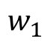
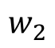
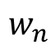
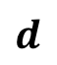
Word Embedding
$$d$$
$$w_{1}$$
$$w_{2}$$
Word Embedding Black-box
$$w_{n}$$

Slide 5
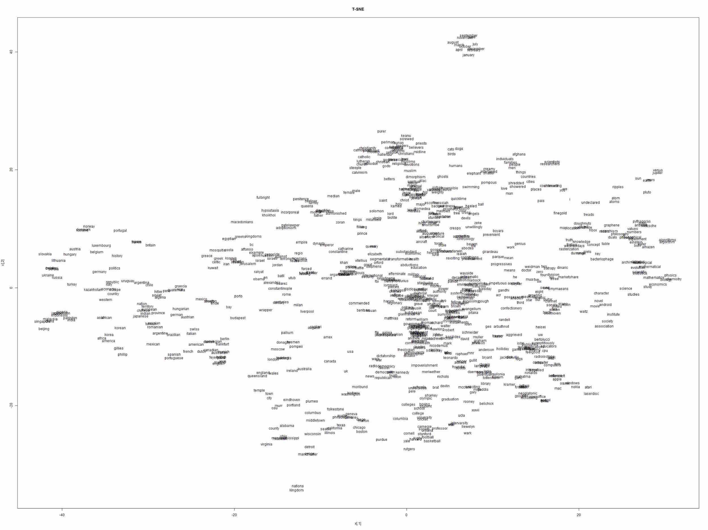
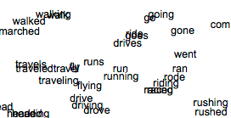

Slide 6
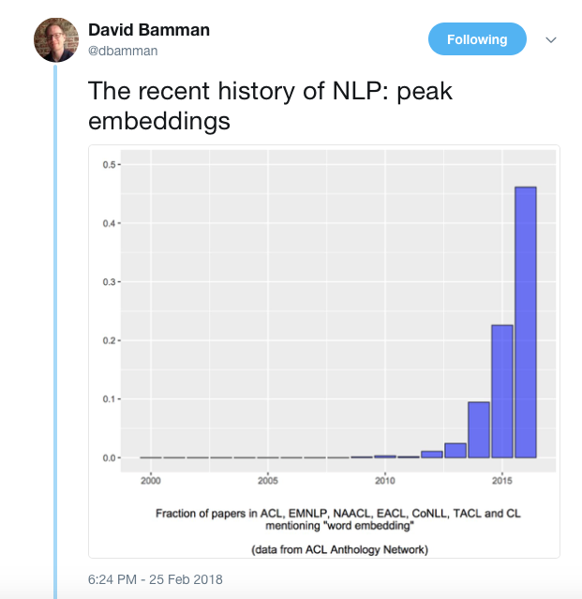

Slide 7
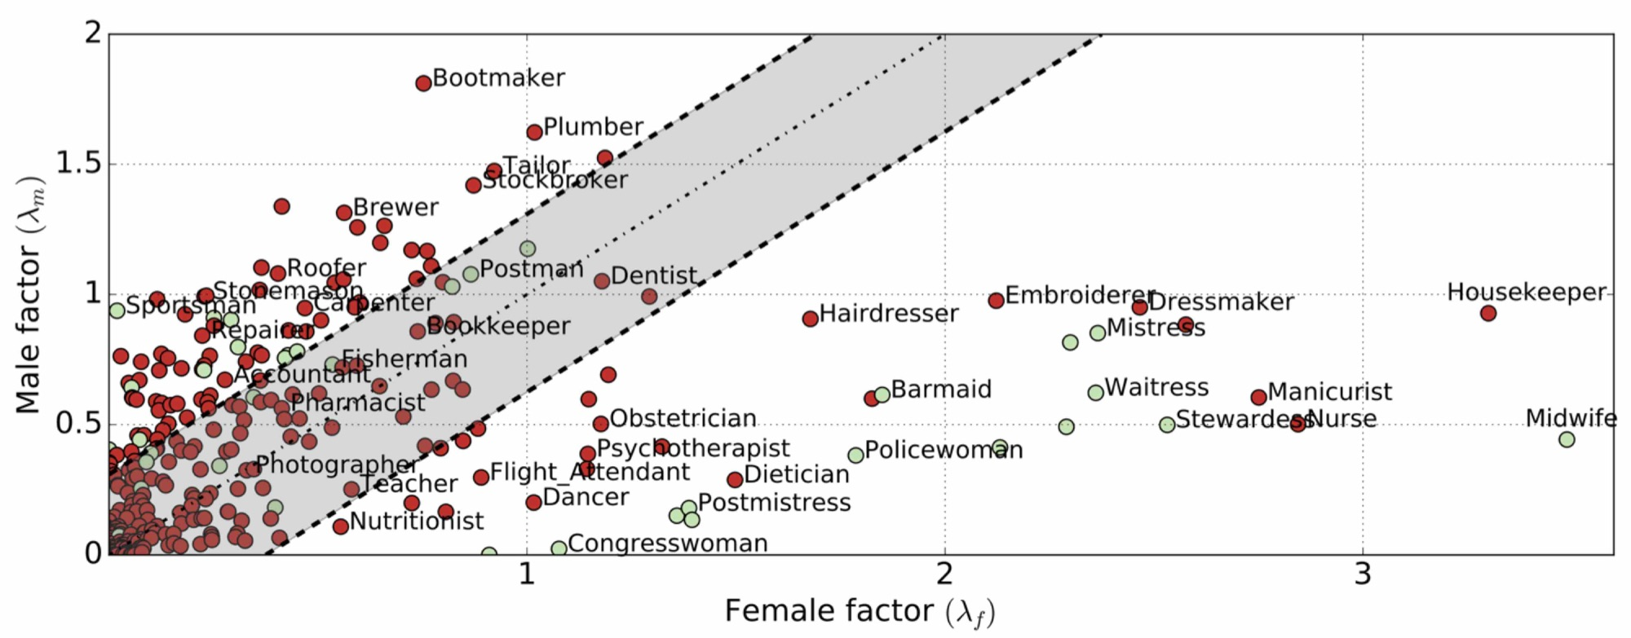
Word Embedding for Gender Bias Study
Processing the text of English Wikipedia
The inclinations of 350 occupations to female/male factors

Slide 8
Word Embedding for Financial Volatility Prediction
return price=(price(t) / price(t-1))-1
volatility=log(std(return prices))
Kogan et al. [2009]
Volatility Prediction using Financial Disclosures Sentiments with Word Embedding-based IR Models
Navid Rekabsaz, Mihai Lupu, Artem Baklanov, Allan Hanbury, Alexander Duer, Linda Anderson
In Proceedings of the Annual Meeting of the Association for Computational Linguistics (ACL 2017)

Slide 9
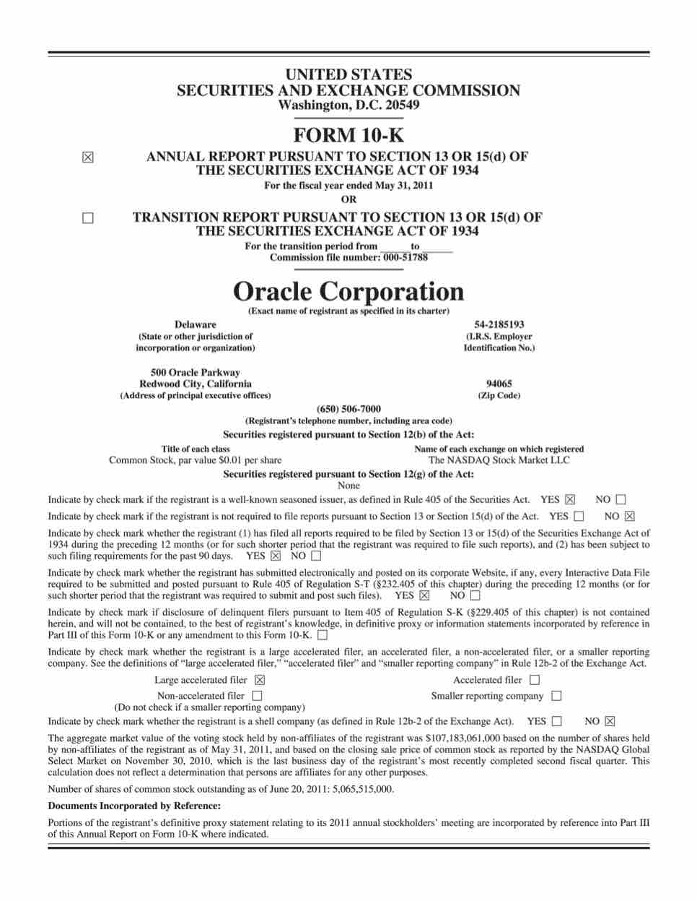
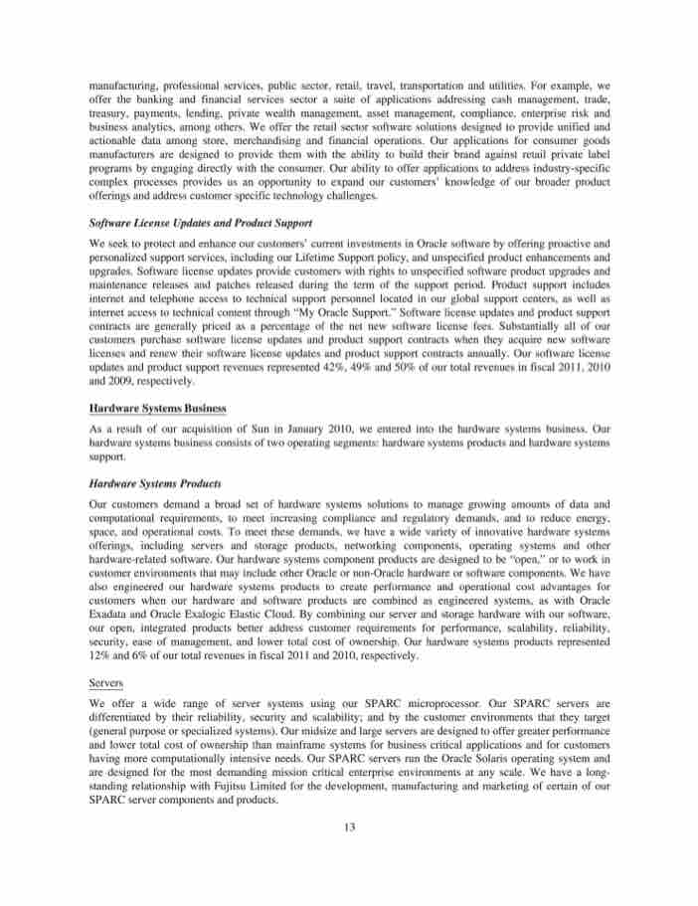

Companies Annual Reports

Slide 10
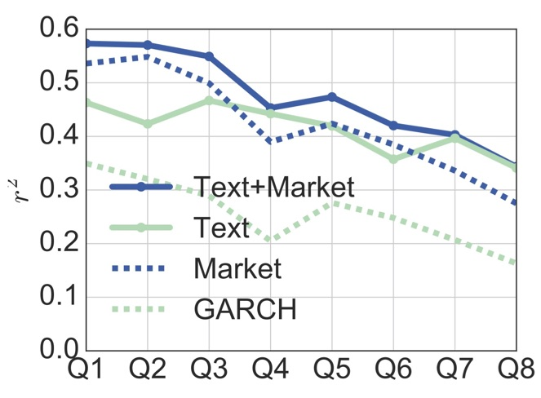
Volatility Prediction with Sentiment Analysis
Sentiment analysis with a word embedding-based method
Text data significantly improves prediction
Prediction performance in the upcoming Quartiles

Slide 11
“You shall know a word by the company it keeps!”
J. R. Firth,
A synopsis of linguistic theory (1957)

Slide 12
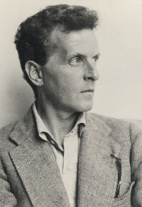
“In most cases, the meaning of a word is its use.”
Ludwig Wittgenstein,
Philosophical Investigations (1953)

Slide 13
alcohol
drink
drunk
on the table
Tesgüino
make
out of corn
fermented
bottle of
Mexico
Nida[1975]

Slide 14
Dutch
drunk
pale
Heineken
brew
red star
bar
drink
green bottle
alcohol

Slide 15
Tesgüino ←→ Heineken
Intuition for algorithms:
Two words are semantically related when they have similar context words

Slide 16
word2vec
A neural word embedding algorithm

Slide 17

Training Data
Window size of 2
http://mccormickml.com/2016/04/19/word2vec-tutorial-the-skip-gram-model/

Slide 18
Basic Neural Architecture
(fox, quick)
Input Layer
Hidden Layer
Decoding
Output Layer
Encoding
Word: fox
Embedding
Context: quick
Linear activation
Word vectors
Context vectors
Softmax
https://web.stanford.edu/~jurafsky/slp3/

Slide 19
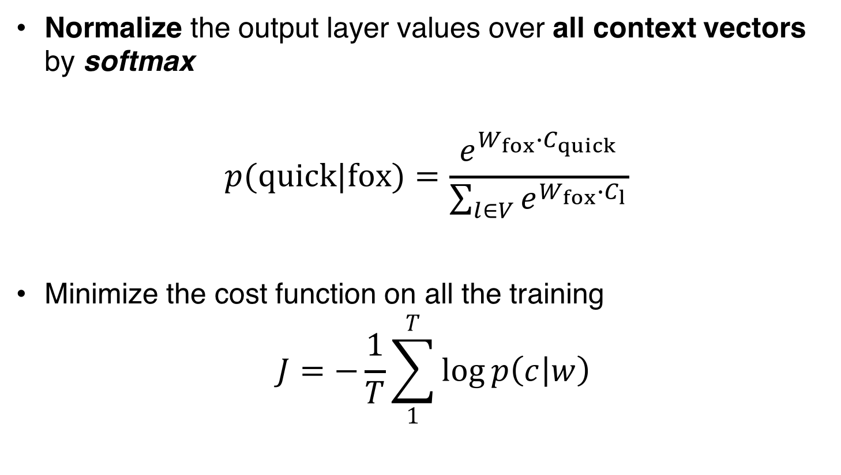
Basic Neural Architecture
Normalize the output layer values over all context vectors by softmax
$$p(quick|fox)=\frac{e^{W_{fox}∙C_{quick}}}{\sum_{l∈V}{e^{W_{fox}∙C_{l}}}}$$
Minimize the cost function on all the training
$$J=−\frac{1}{T}\sum_{1}^{T}{\log{p\left(c | w\right)}}$$

Slide 20
Word vector

Slide 21
Word vector

Slide 22
Tesgüino
Heineken
Word vector

Slide 23
Tesgüino
Heineken
Word vector

Slide 24
Tesgüino
Heineken
Word vector
Context vector

Slide 25
drink
Tesgüino
Heineken
Word vector
Context vector

Slide 26
drink
Tesgüino
Heineken
Word vector
Context vector

Slide 27
drink
Tesgüino
?
Corpus: (Heineken, drink)
Question
How Long Should be the size of the Arrow??
Heineken
Word vector
Context vector

Slide 28
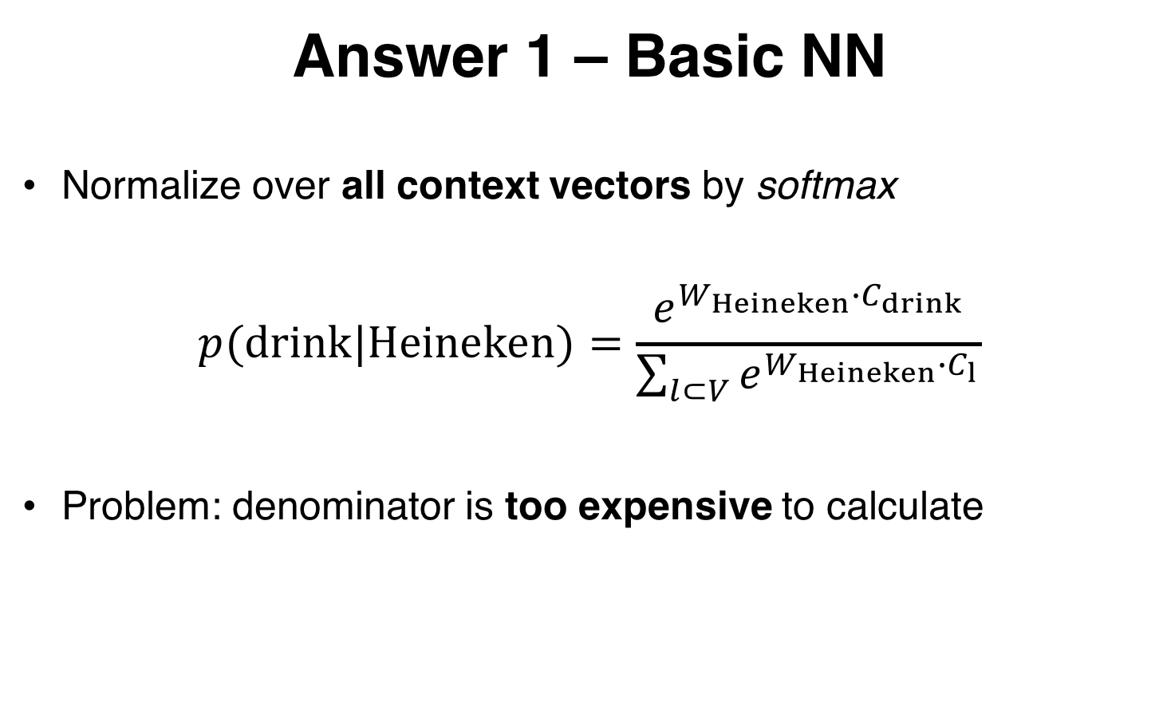
Answer 1 – Basic NN
Normalize over all context vectors by softmax
$$p(drink|Heineken)=\frac{e^{W_{Heineken}∙C_{drink}}}{\sum_{l⊂V}{e^{W_{Heineken}∙C_{l}}}}$$
Problem: denominator is too expensive to calculate

Slide 29
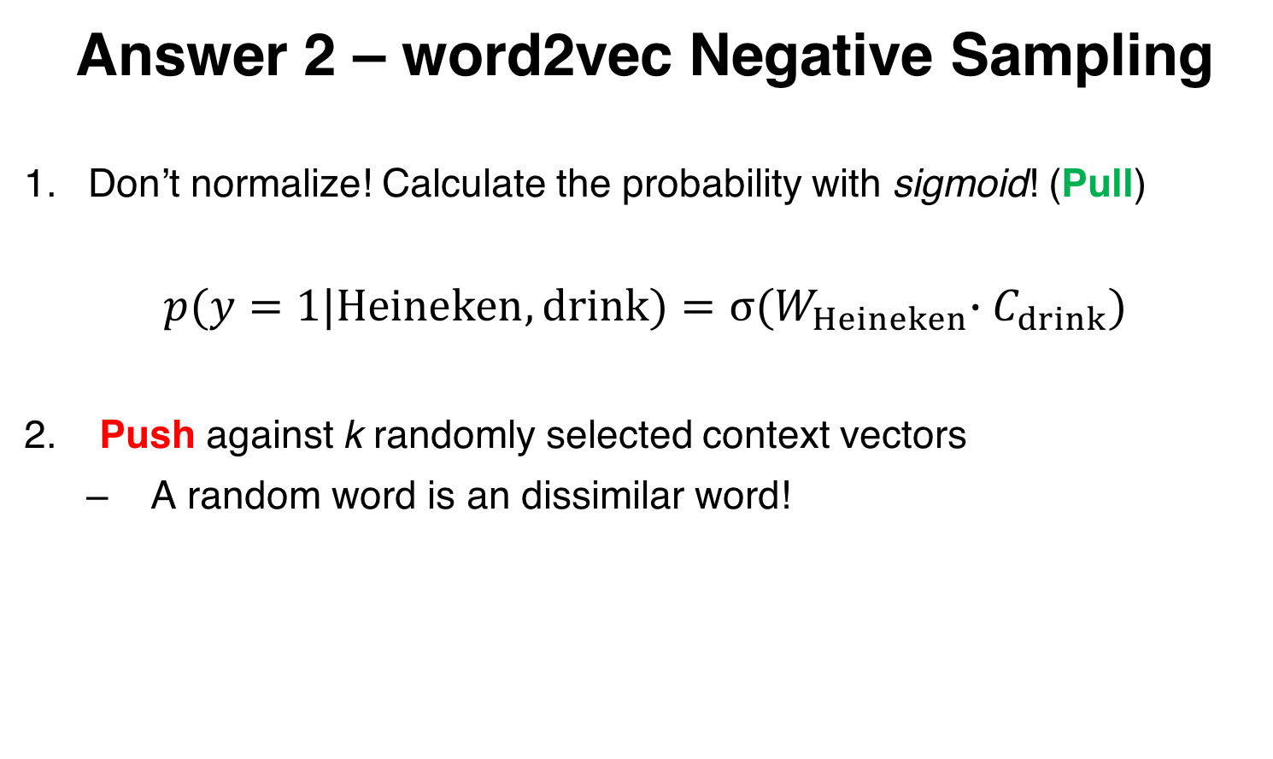
Answer 2 – word2vec Negative Sampling
Don’t normalize! Calculate the probability with sigmoid! (Pull)
$$p(y=1|Heineken,drink)=σ{{(W}_{Heineken}∙C_{drink})}$$
Push against k randomly selected context vectors
A random word is an dissimilar word!

Slide 30
drink
Tesgüino
?
Use sigmoid for Pull factor.
Heineken
Word vector
Context vector

Slide 31
drink
Tesgüino
Move! (update vectors)
Select k context words randomly.
Calculate push factors.
Heineken
Word vector
Context vector

Slide 32
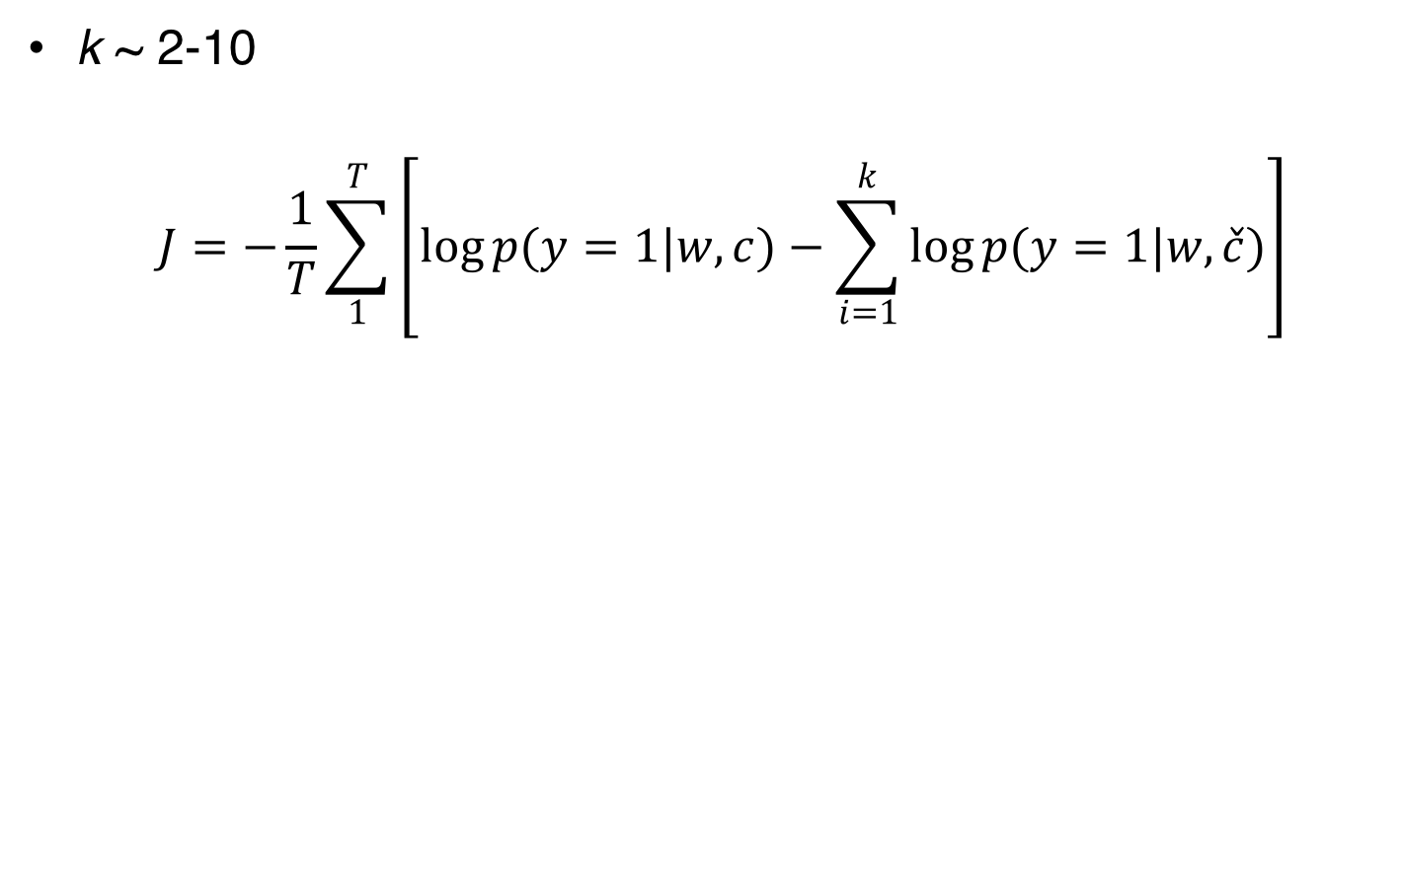
Cost Function of word2vec with Negative Sampling
k ~ 2-10
$$J=−\frac{1}{T}\sum_{1}^{T}{\left[\log{p(y=1|w,c)}−\sum_{i=1}^{k}{\log{p(y=1|w,\check{c})}}\right]}$$
Genuine co-occurrence probability
Randomly sampled probability

Slide 33
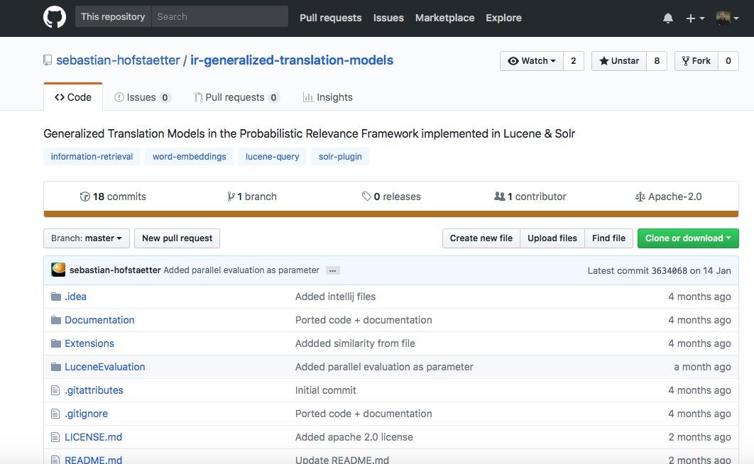
Word Embedding for Search Engines
Open source library for document retrieval
Effectively combining word embedding with retrieval models
Implemented for Solr and Lucene

Slide 34
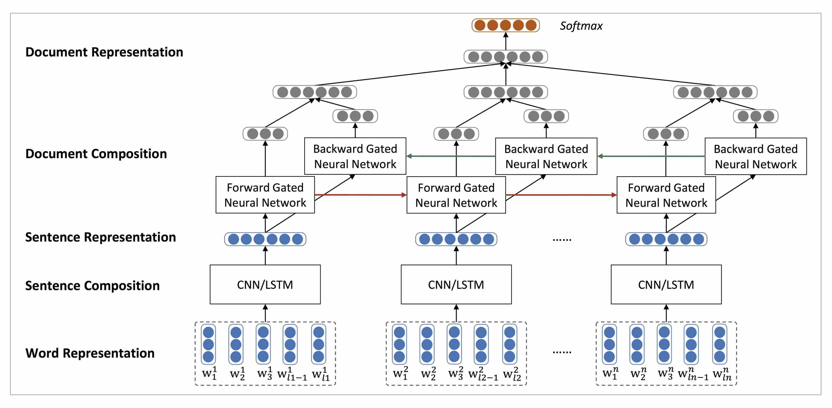
Challenges and Perspective
Task and domain specific representation learning
Representation learning bigger language elements
Interpretability, transparency, and fairness
Alzheimer
Alzheimer
MS
MS
Multiple sclerosis

Slide 35
Thanks!
@navidrekabsaz
rekabsaz@ifs.tuwien.ac.at

